Slide 1
TRUENAT EQA PORTAL
External Quality Assurance For Rapid TB (NAAT) Testing
Log on to : www.naateqa.in

Slide 2
Objectives
To simplify and streamline the process for data submission, collection, monitoring and compilation from all participating sites
To provide an acknowledgement receipt to site upon submission of results
To simplify monitoring at NRL and IRL level (easy navigation of results/ reports)
To support PT provider for analysis of the data and finalization of reports and automate report dissemination to the respective site
To generate reports as per State-wise, NRL, IRL and Lab-wise.
To build a system for tracking of panels (from dispatch by PT provider to confirmation of receipt by the participating site)
To simplify system for registering sites for participating in TRUENAT EQA round (including machine details)
By FIND India

Slide 3
Key features
It helps to reduce the errors in the manual analysis
It allows for online
Registration of lab
TRUENAT EQA machines
Updating lab profile
Confirmation of receipt of panels
Submission of PT Results, etc.
Pdf/Jpg file uploading
Automatic acknowledgement slip sent to lab email id after sample report submission
Online EQA feedback result sent to respective labs
Able to generate excel sheet by NRL/IRL for easier monitoring and review.
Combine Report of all labs auto generated, easier to validate result by Admin/PT Providers

Slide 4
NRL Roles
IRL Roles
Register Lab (own lab)
View registered labs under NRL
Tracking of Panels sent by PT Provider
View comments of IRL in PT Results
Add comments of NRL in PT Results
Able to generate excel sheet by NRL/IRL for easier monitoring and review.
Register Labs
View registered labs under IRL
Tracking of Panels sent by PT Provider
Add comments of IRL in PT Results
Able to generate excel sheet by IRL for easier monitoring and review.

Slide 5
Roles of Labs
Receive User Id and Password via Email on registered Email Id.
Change Password
Update Lab Profile including personnel details
Add TRUENAT Machine/s details
Acknowledge receipt of panels
Enter PT Results
Review and submit PT Results
Receive by Email PT result from PT Provider

Slide 6
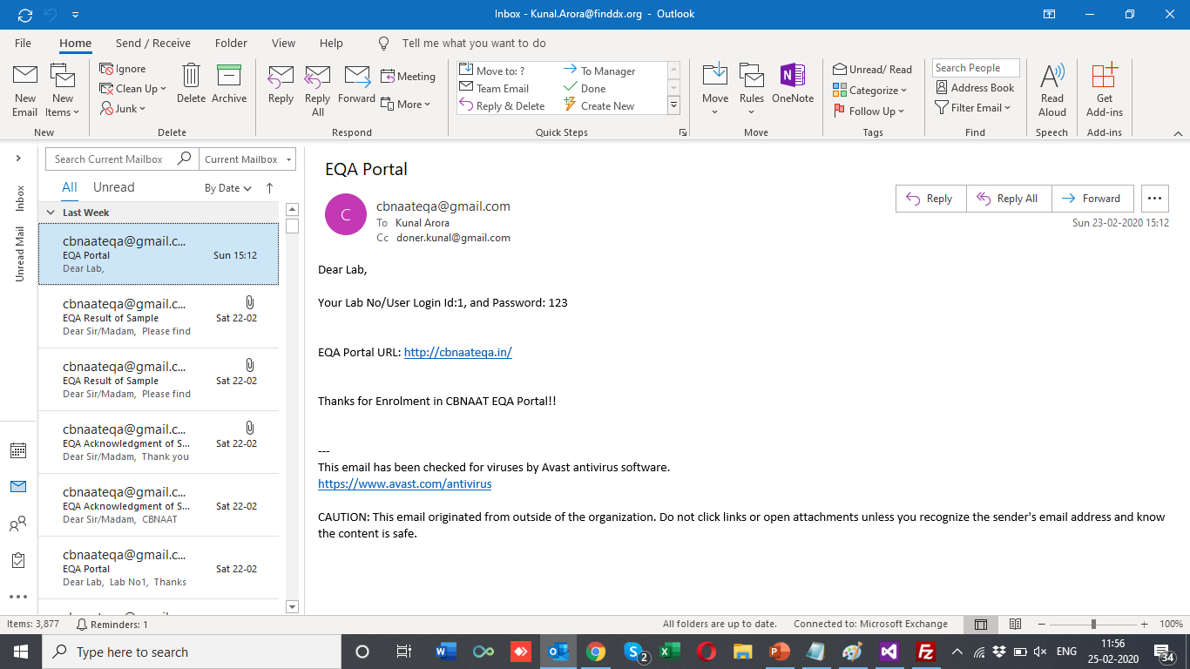
Lab credentials sent on Email
By FIND India

Slide 7
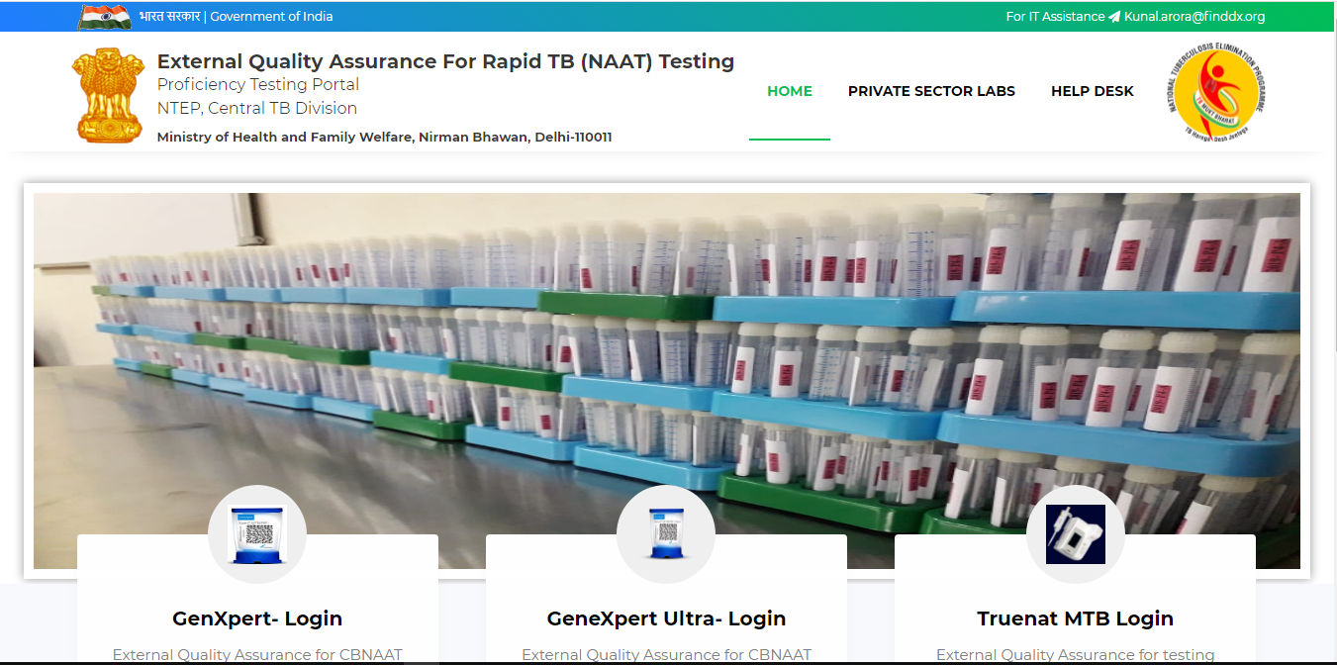
Log on to : www.naateqa.in

Slide 8
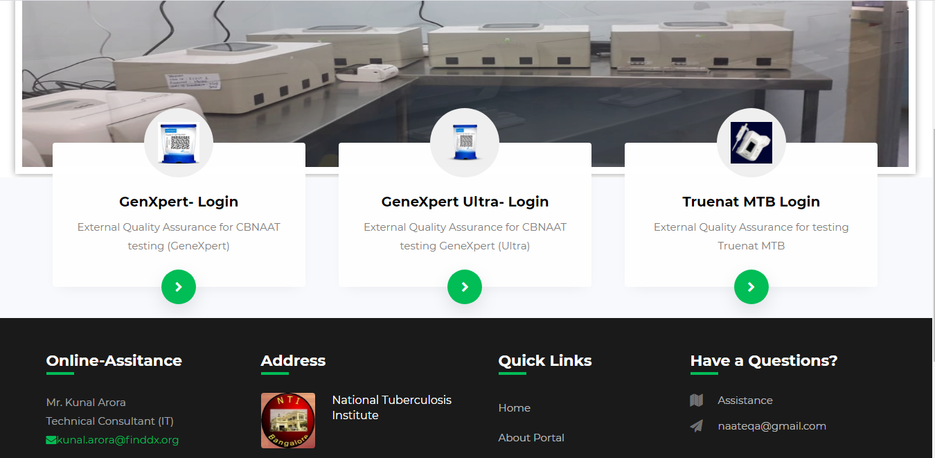
Select
Truenat MTB Login for entry

Slide 9
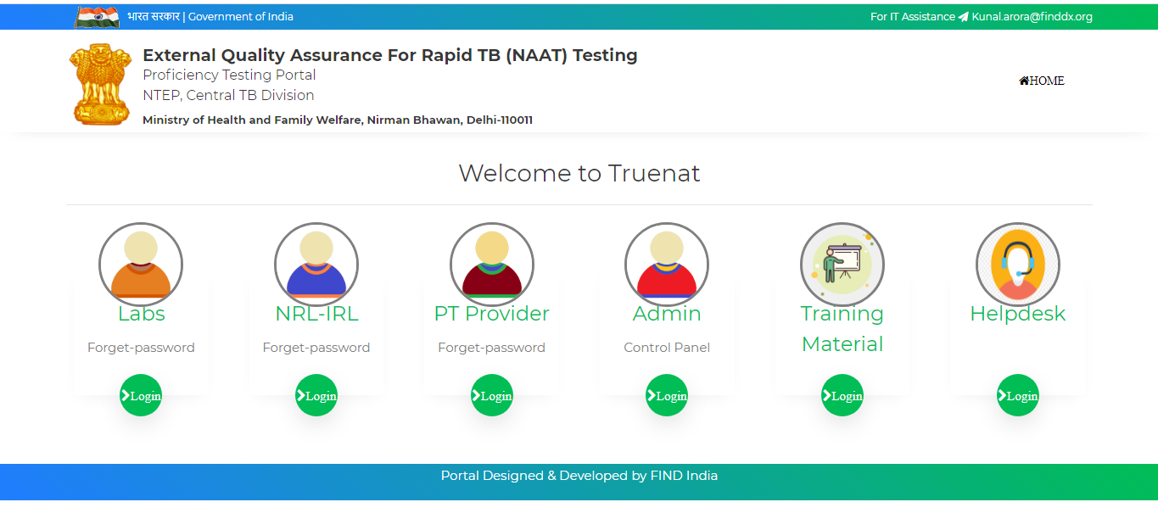
Login Page
By FIND India

Slide 10
Thank You
By FIND India

